Slide 1
Microsoft Learn Student Ambassador
ML-101: A Perfect Introduction
Hands-on Machine Learning
Powered by Artificial Intelligence
Shubham Varma (Alpha MLSA)
Khushi Trivedi (Alpha MLSA)
30-July-2022, 6:15 PM (IST)

Slide 2

About the host
Shubham Anil Varma
Alpha Microsoft Learn Student Ambassador
Community Mentor at SMLRA
Summer Student @International Institute of Information Technology-Hyderabad
Head of R&D Department at TKR
Contributor @GSWOC’21
Several other Internships ☺
B.Tech - K. J. Somaiya College of Engineering, Mumbai. 2nd year, IT-Artificial Intelligence.

Slide 3

About the host
About the host
Khushi Trivedi
Founder & Lead: GDSC chapter LNCT&S
Alpha Microsoft Learn Student Ambassador
Data Science Trainee @ DevTown
Research Fellow @ Indian Space Society
IAAC’21 Bronze Honour Winner
NASA citizen Scientist
Summer Student @ Indian Institute of Astrophysics, Bangalore
B.Tech - Lakshmi Narain College of Technology & Science, Bhopal. 2nd year, CSE-Cyber Security.

Slide 4
What is MLSA?
Microsoft Learn Student Ambassador is a program that aims to bring together students around the globe who:
have passion for technology,
craze to learn new technology,
help the community, and contribute significantly.
They are the student leaders with a passion for making a difference, building and managing vibrant communities, and sharing the latest tech with their peers.

Slide 5

Perks of being an MLSA
Grow your skills with the in-demand technologies
Connect with global community and tech leaders.
Build your reputation as a tech insider
Lead your local tech community
Empower your peers, and earn recognition
Get cool swag kits from MLSA
Get access to premium Microsoft technologies for free!

Slide 6
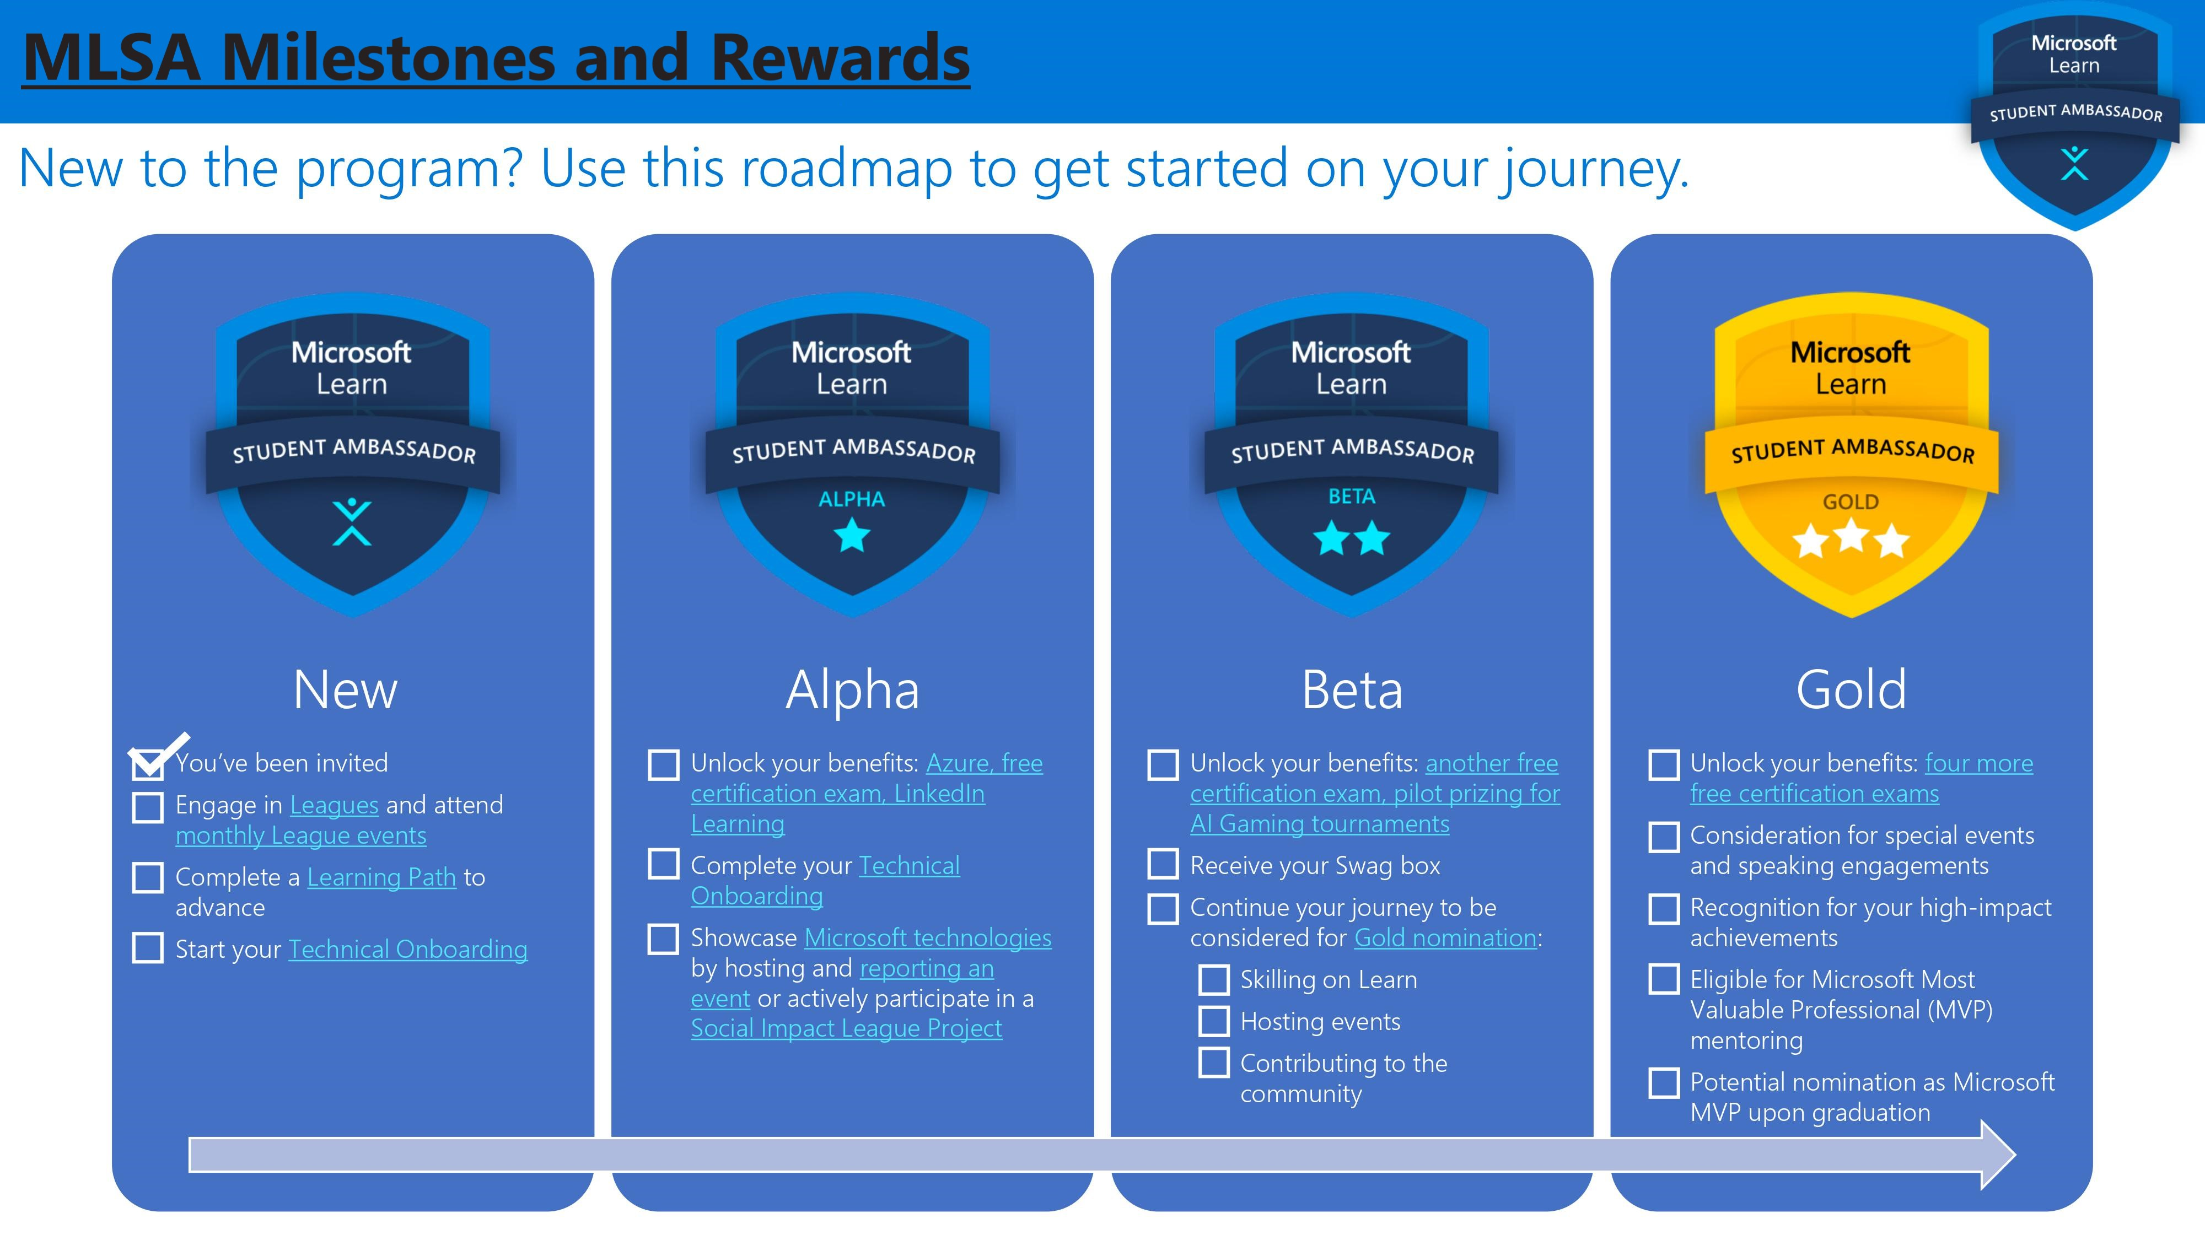

Slide 7
What is Machine Learning?
Branch of Artificial Intelligence (AI) that focuses on the use of data & algorithms to imitate the way humans learn, gradually improving it’s accuracy.
Ability to perform tasks without explicit instructions and relying on patterns.
Can make predictions through pattern recognition.
Artificial Intelligence:
Development of smart systems and machines that can carry out tasks that typically require human intelligence.
Branch of Artificial Intelligence (AI) that focuses on the use of data & algorithms to imitate the way humans learn, gradually improving it’s accuracy.
Ability to perform tasks without explicit instructions and relying on patterns.
Can make predictions through pattern recognition.
Artificial Intelligence:
Development of smart systems and machines that can carry out tasks that typically require human intelligence.

Slide 8
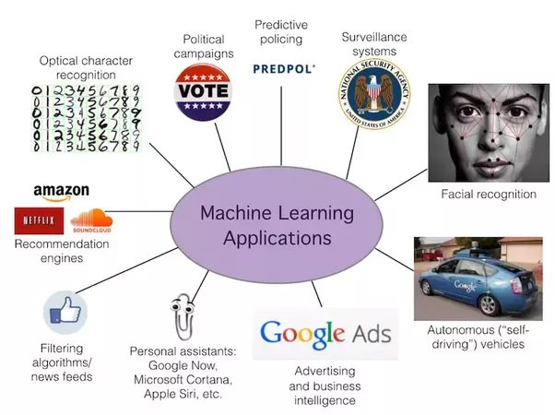

Slide 9
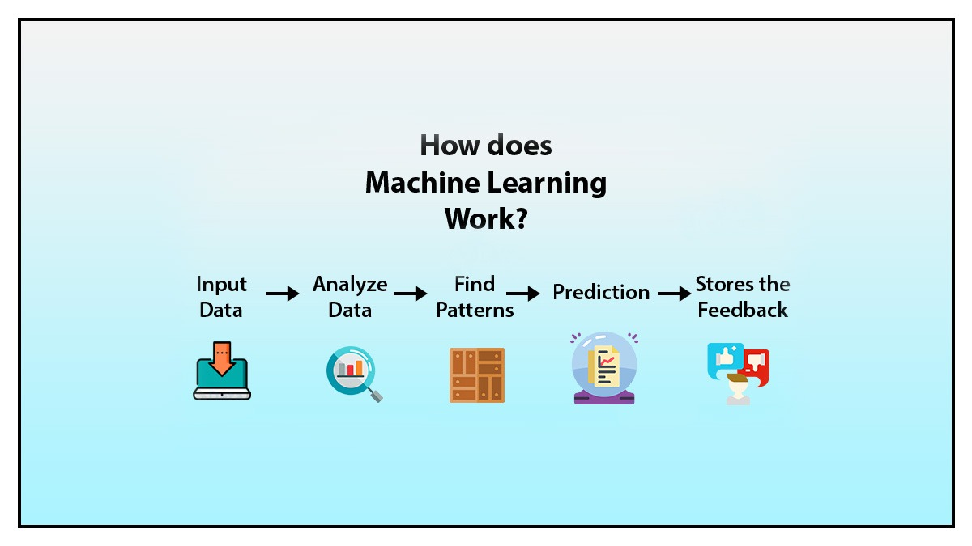

Slide 10

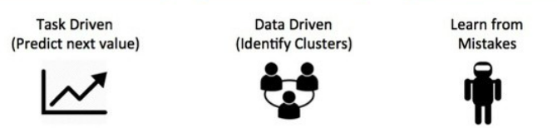
Types of Machine Learning Algorithms
Supervised Learning
Unsupervised Learning
Reinforcement Learning

Slide 11


Slide 12
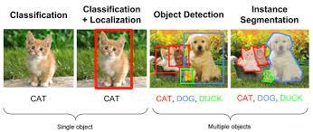
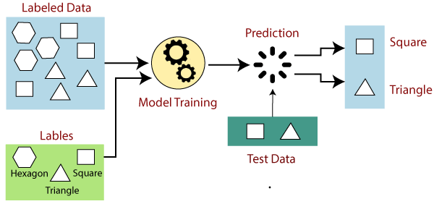
Supervised Machine Learning
Labels are given with the data

Slide 13
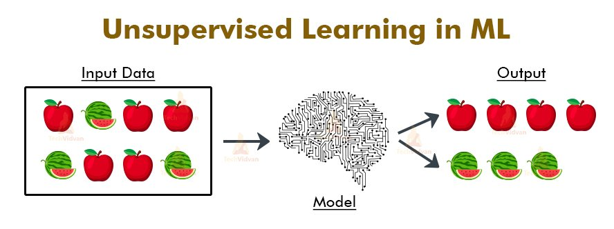
Unsupervised Machine Learning
No labels given to the data

Slide 14
Supervised ML | Unsupervised ML
Labelled data is used | Labels are not used in the data.
Input and output data provided to the model. | Only the input data is provided to the model
It needs supervision. | Doesn’t need any supervision.
Produces accurate results. | Gives less accurate results.
We need to first train the model and then it predicts output. | The model learns on its own like a child learns with his experiences.

Slide 15
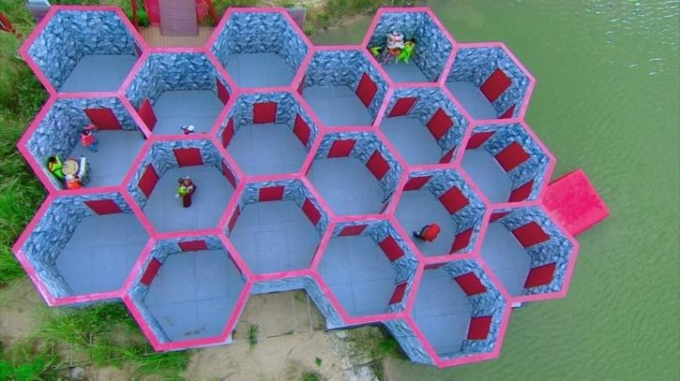
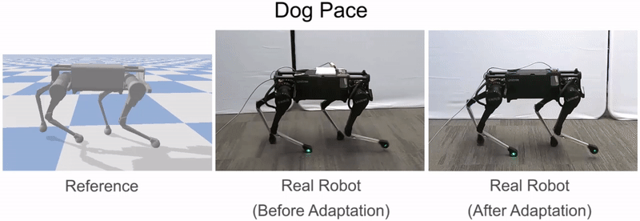
Reinforcement Learning:
Reinforcement learning is a type of machine learning method where an intelligent agent (computer program) interacts with the environment and learns to act within that.
How a Robotic dog learns the movement of his arms is an example of Reinforcement learning!

Slide 16
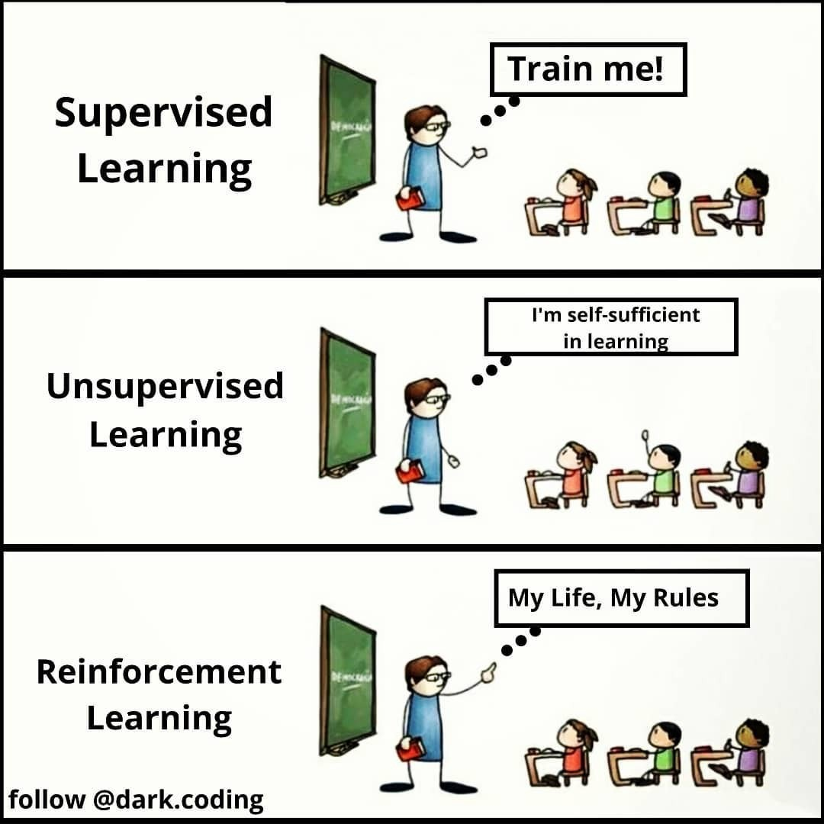
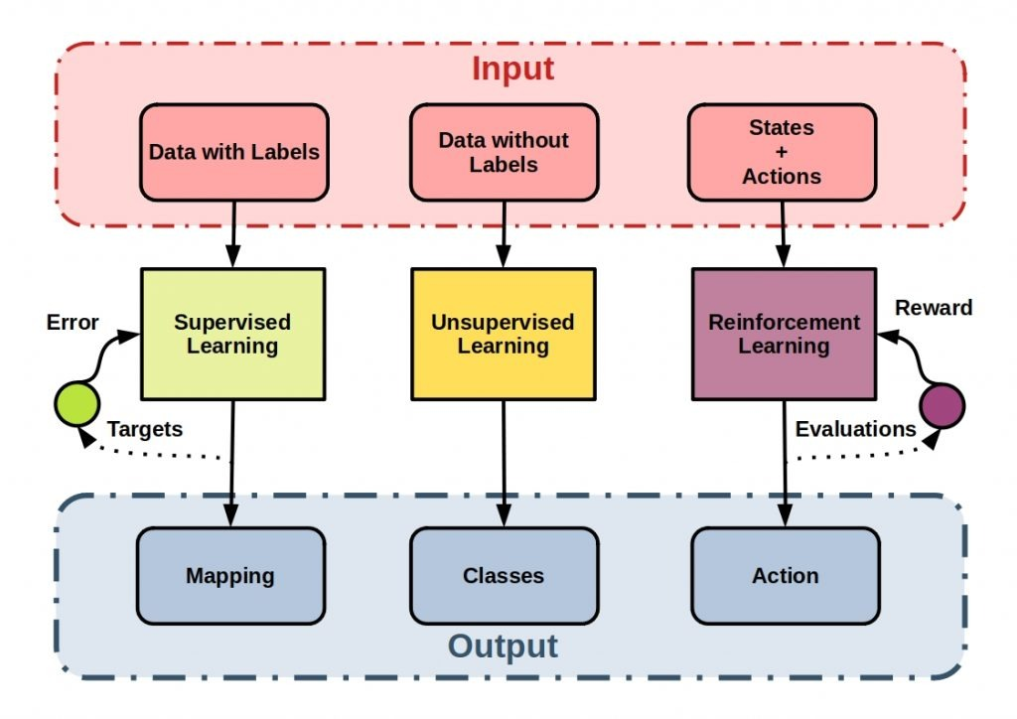

Slide 17
Linear Regression
(Supervised Learning)

Slide 18
What is Linear Regression?
Linear – Line
Regression – relation between data points/ values
(one of which is a dependent variable and another is independent variable)
It is used to predict the value of a variable based on the value of another variable.
The variable you want to predict is called the dependent variable.
The variable you are using to predict the other variable's value is called the independent variable.

Slide 19
Why do we use Linear Regression?

Slide 20

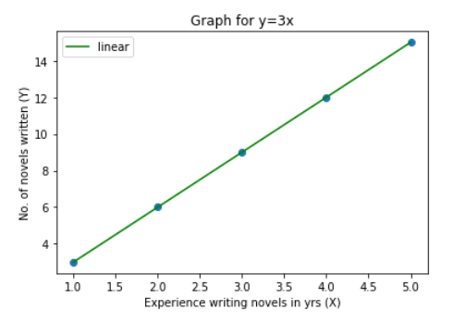
Example 1 :
Predicting the number of novels written by an author!
Find the relation between X and Y in the following case:
Experience writing novels in yrs (X) | No. of novels written (Y)
1 | 3
2 | 6
3 | 9
4 | 12
5 | 15

Slide 21
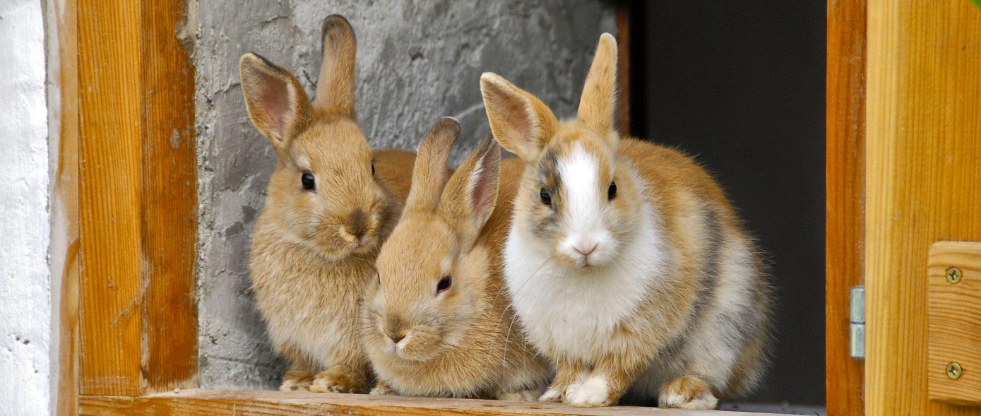
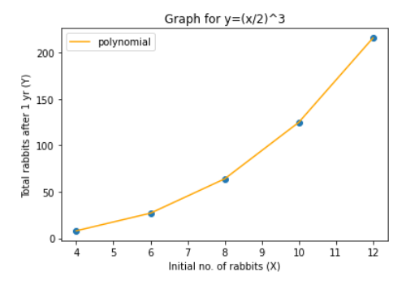
Example 2:
Predicting the number of rabbits after certain years!
Initial no. of rabbits (X) | Total rabbits after 1 year (Y)
4 | 8
6 | 27
8 | 64
10 | 125
12 | 216
When x = 7, y ≈ 5 (42.875) ; x = 9, y ≈ 90 (91.125)
We can now predict Y if we have any value of X

Slide 22
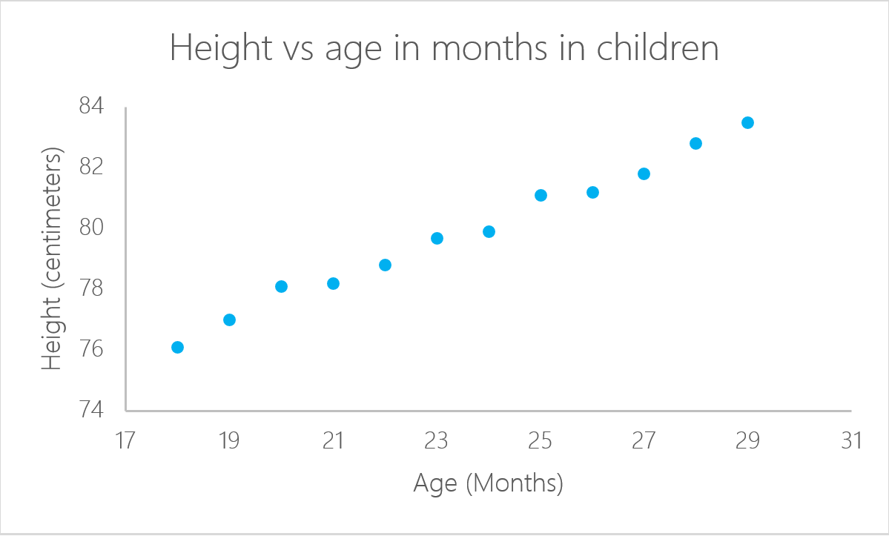
A realistic Example
After plotting the line, we can get the height for any given age.

Slide 23
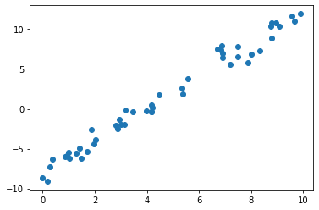
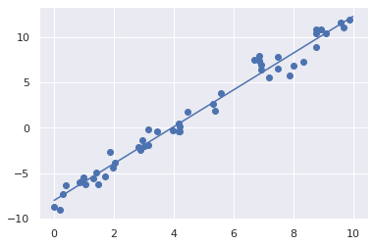
A random set of points
Finding the best line to represent those points

Slide 24
How does the Machine find the ‘best’ line?
We give the machine a lot of data and ask it to find the line passing through the majority of the points.
For a line y = mx +c, m and c are the parameters of the line.
The Machine needs to adjust ‘m’ and ‘c’ so that it gets the best line representing the given points. m and c are known as hyper-parameters.
Tweaking m and c will help us predict the generalized line that passes through most of the data and we can thus find a general pattern in the data.

Slide 25
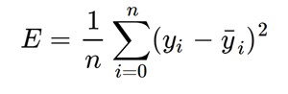
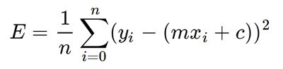
How to get the values of ‘m’ and ‘c’?
We initially take random values of m and c so as to get a random line, define a function to measure how ‘good’ the line actually is, and modify the m and c values accordingly.
We’ll call the function to be used as loss function. It will take the line (m and c values) and give us a measure of how good that line represents our data.
For that , we calculate the error, which is the difference between actual value (data point) and predicted value (given by a particular line). We calculate the sum of such errors for all the data points and that gives us the total error in a particular representation of line.
We took the square of difference as we need absolute value of error

Slide 26
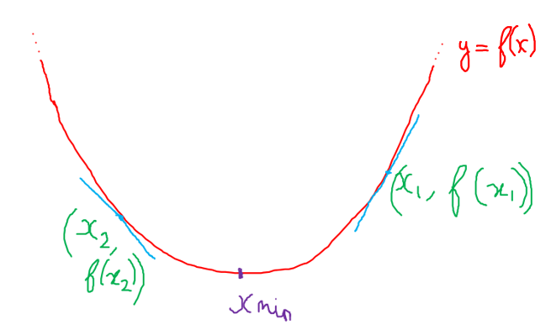
Minimizing the error would make the line pass closer and closer through the majority of the data points
But how do we find the minima of the loss function?
Enter Gradient Descent

Slide 27
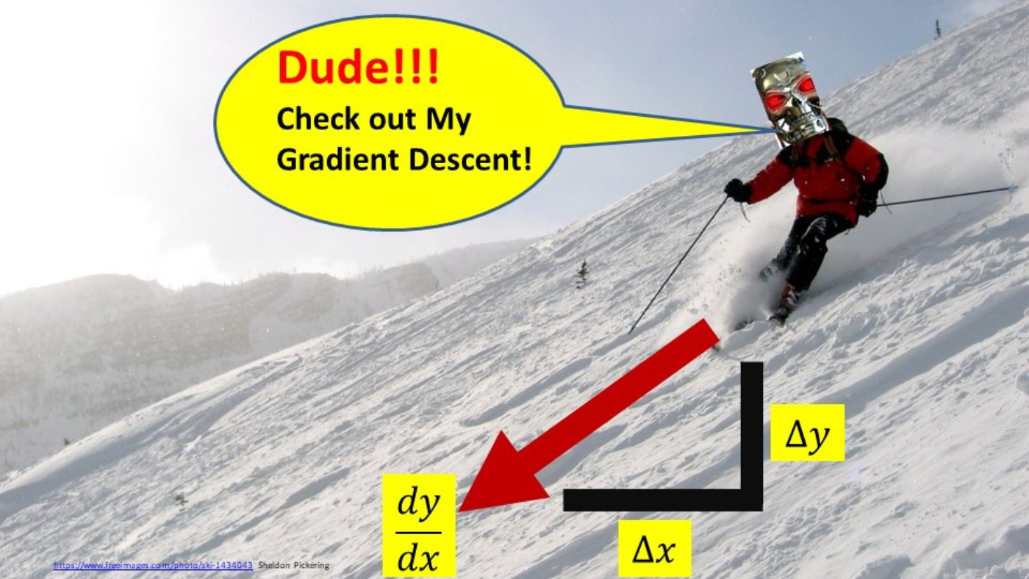
Gradient Descent
Gradient Descent is an iterative algorithm used to find the minima of a particular function. Or in our case, it is used to calculate the values of m and c such that the error generated is minimum
Refer Graph – Derivative gives direction, Learning rate gives step size
Larger learning rate = bouncing back of x value, lesser learning rate = more iterations
Epoch = total no of iterations

Slide 28
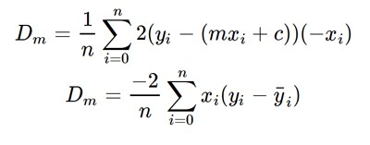
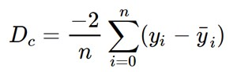
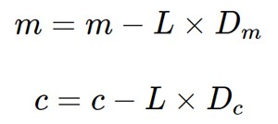
To get ideal values of m and c, we define y = f(m) and y = f(c) separately, calculate the best values of m and c individually and then we get the best line with those values of m and c
Partial Derivative wrt m: Partial Derivative wrt c:
In each iteration, we do:
Finally we get m and c with accuracy depending on the epoch

Slide 29
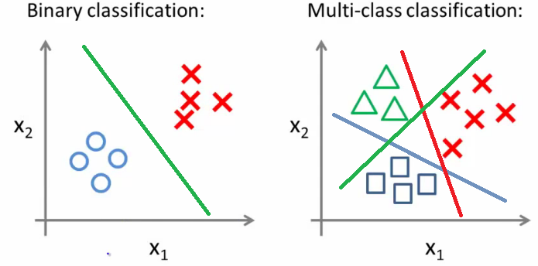
Logistic Regression

Slide 30


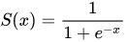
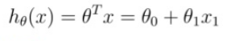

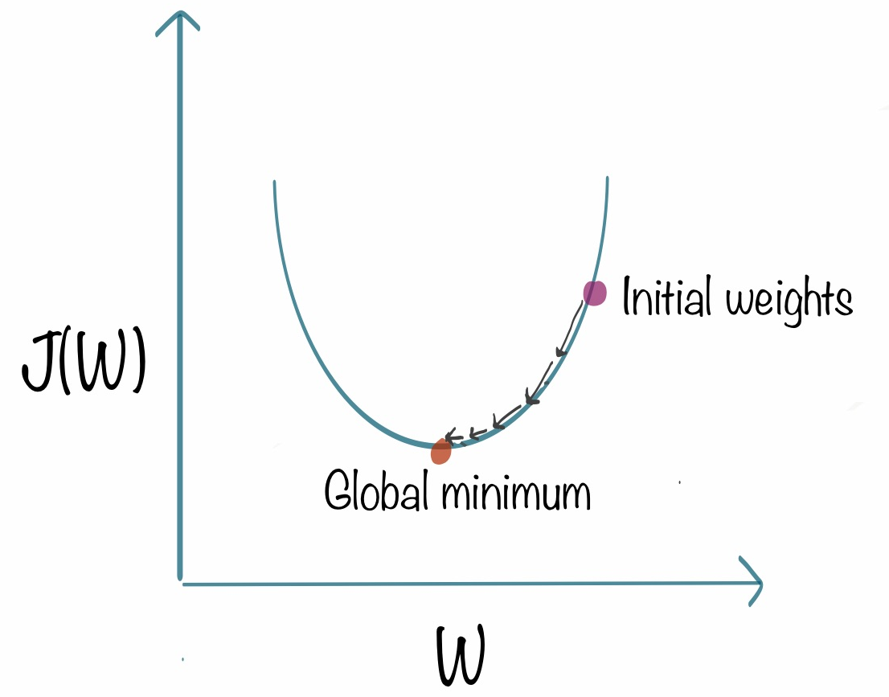
Linear Regression
Sigmoid
Hypothesis :
Optimizer used :

Slide 31
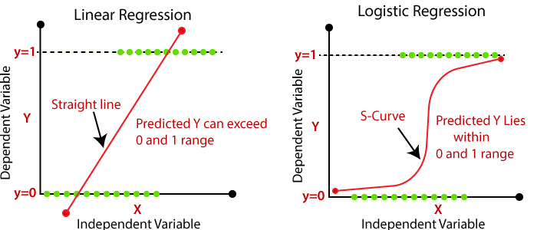
Downsides in Logistic Regression if we use the same hypothesis function as of Linear Regression
Tip
1 ≥ h(x) ≥ 0
h(x) = P(Y|X)
Y is Binary(0 or 1)

Slide 32
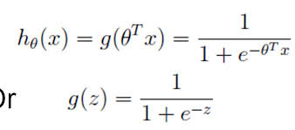
Logistic Regression
Hypothesis :
Cost Function ??
Goal : Minimize Cost Function
Hypothesis:
Tip
Cost Function is a function that measures the performance of a Machine Learning model for given data.

Slide 33
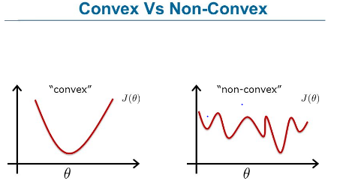
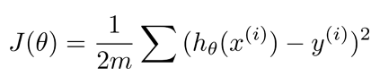

Linear Regression
Convex Function
Non - Convex Function
By the end of this section, your audience should be able to visualize:
Cost function :
What if we use the same Cost function?
Tip
h(X) is a complex function
Non-convex don't reach minima easily

Slide 34
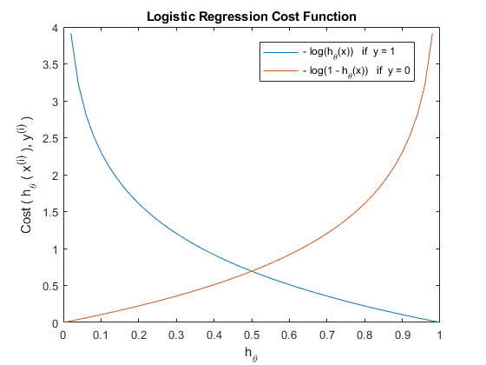
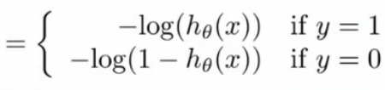
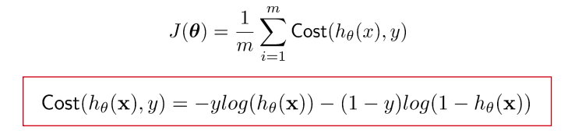
Logistic Regression
Cost Function

Slide 35
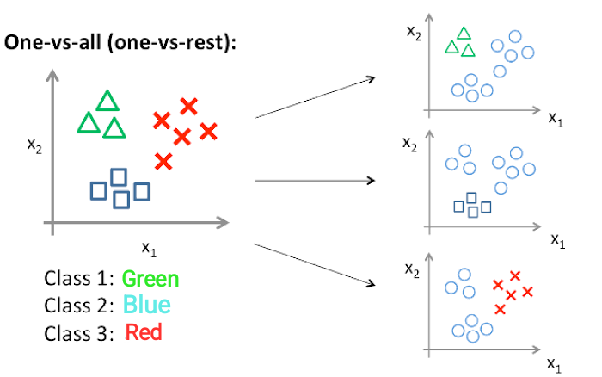

Slide 36
K-Means Clustering Algorithm

Slide 37
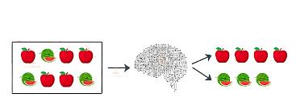
What is Unsupervised Learning?
Analyze unlabeled data
Labels or scores are not provided for training data
Algorithms discover hidden patterns without the need for human intervention
Ideal for Data Analysis, Customer segmentation and Image Recognition.
INPUT
Model
OUTPUT

Slide 38
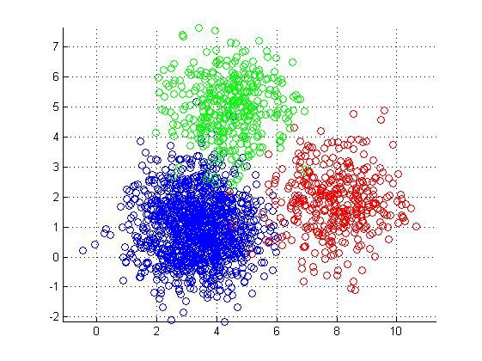
Then what is Clustering?
Data Mining Technique
Group unlabeled data based on their “similarities” or “differences”
Exclusive/Hard clustering
Hierarchical clustering
Probabilistic/Soft clustering

Slide 39
What does “K” really mean?
K → Number of clusters we want to form
Mean → Measure of similarity will be Distance

Slide 40
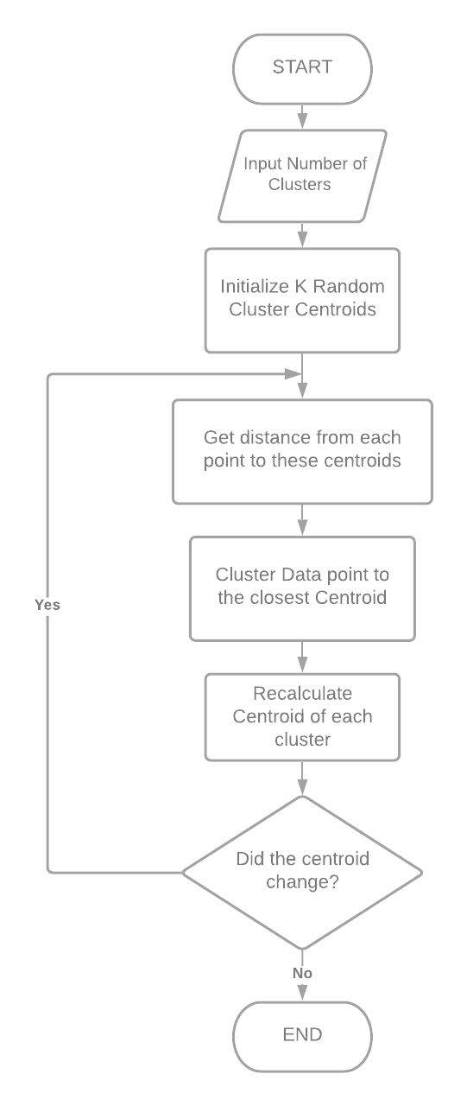
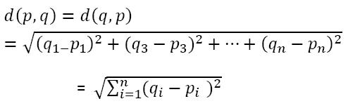
For a fixed number of clusters
Calculation of Distance
For n dimensions

Slide 41
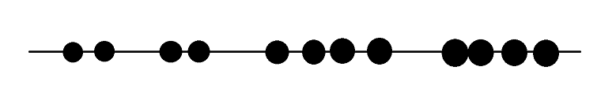



Evaluating Clusters
Lack of a direct loss function
1 Dimension Example:
Q. Which Clustering is the Best? Vote in the poll!
A. B. C.

Slide 42

Concept of Variance and WCSS
Answer: B
But what do these lines represent?

Slide 43
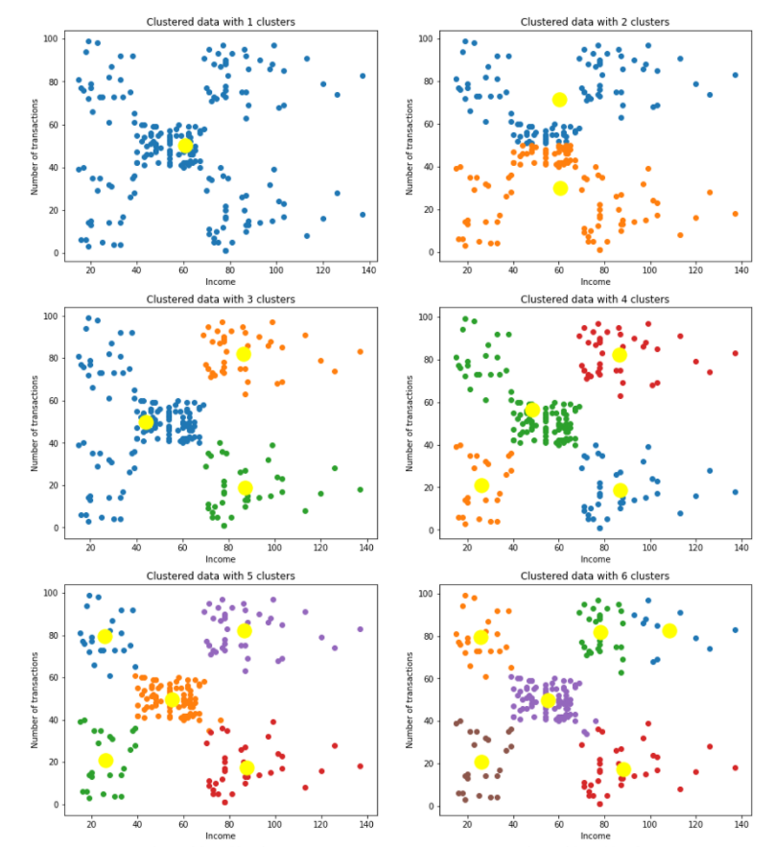
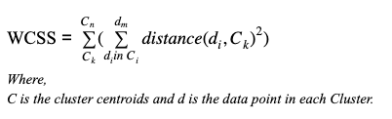
Concept of Variance and WCSS
Sum of squares of distances of every data point from its corresponding cluster centroid which is called WCSS ( Within-Cluster Sums of Squares).

Slide 44
How to select K?
Elbow method
Perform K means clustering on different values of K ranging from 1 to any upper limit.
For each K, calculate WCSS
Plot the value for WCSS with the number of clusters K.
The location of a bend (knee) in the plot is generally considered as an indicator of the appropriate number of clusters. i.e. the point after which WCSS doesn’t decrease more rapidly is the appropriate value of K.

Slide 45
Supporting the Support Vector Machines
(SVMs)

Slide 46
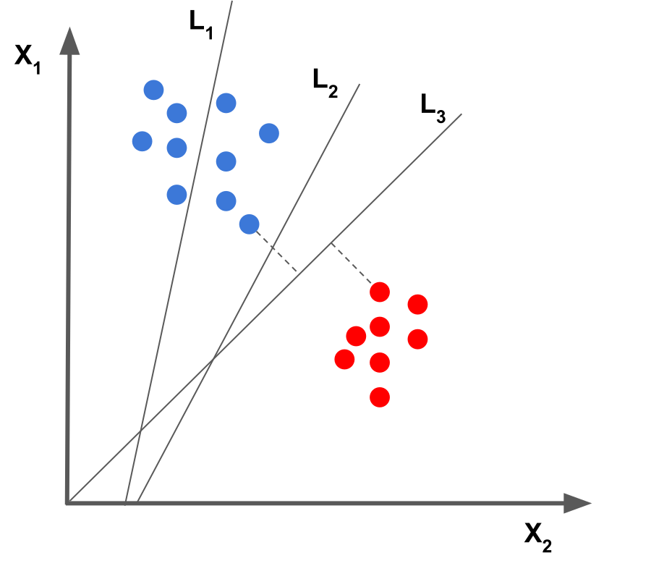
Which Decision Boundary best fits the given data?
Hint: Try to think in terms of patterns and corner points!
Note: Never forget about extending concepts in n-dimensions

Slide 47
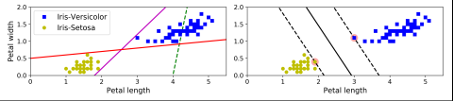
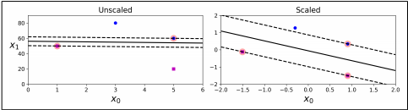
Decision boundary of the left plot is not good as compared to right plot.
Data when not scaled can have adverse effects like one feature not having much importance
Addition of data that is on either side of the street won’t affect the model.
Best with datasets of small-medium range. ~10k because time complexity can go over cubic for certain kernels.

Slide 48
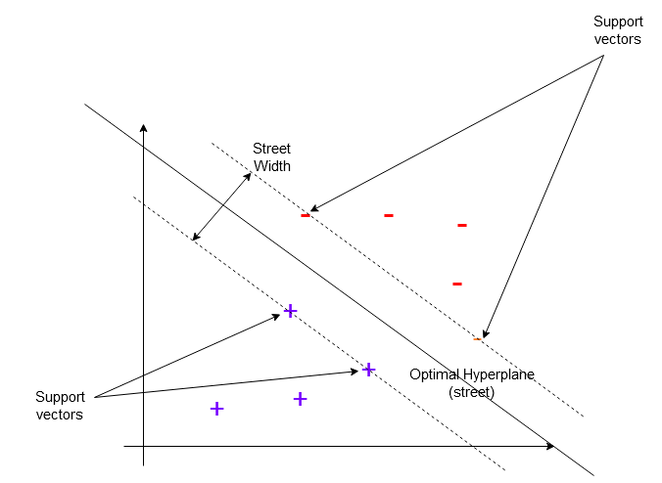
Jargon Alerts !
Street
Street Width
Support Vectors
Hyperplane

Slide 49
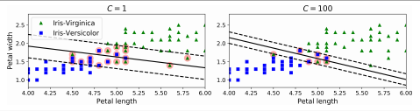
Soft Margin and Hard Margin Classification
In hard margin classification the instances are strictly on their side of their street.
In soft margin classification some street violations are allowed.
The amount of violations that are tolerated depends on the hyperparameter c.
c is the inverse of the tolerance.
The lower it is the wider the street is and the better it generalizes.

Slide 50
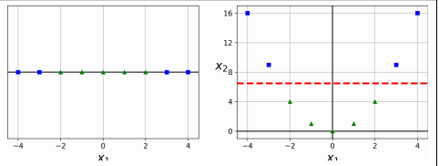
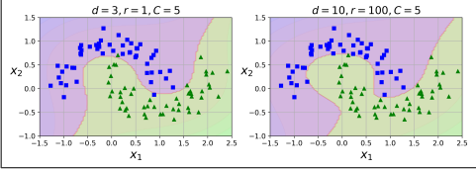
Non linear data
Not all data is linear and thus linearly separable.
Converting linear data to high dimension data gives it more features and thus makes it more separable.
Higher the degree will be the closer will be the fit. It’s a hyperparameter that can be tuned.

Slide 51


Kernel Trick
Separates non-linear data
Doesn’t actually convert data vectors in higher dimensions, just assumes!
The above computation for dot product using kernel

Slide 52


Support Vector Regression
Similar to SVC’s but the main intuition is to increase the width of the street instead of reducing it to accommodate the maximum number of instances.
The decision boundary is actually the line of best fit.
Unlike other models that try to minimize the error between the real and predicted value, SVR tries to fit the best line within a threshold value.
The threshold value is the distance between the hyperplane and boundary line.
Like SVC’s non linear data is also considered.
Eta is a hyperparameter which decides the width of the street.

Slide 53

Maths behind SVMs
We try to is maximize the width of the street to find optimum hyperplane
Variables:
w - perpendicular vector to decision boundary
x,y - support vectors of two classes
b - the decision boundary constant.

Slide 54




Easy way to calculate street width
Step 1: Defining Width
Step 3: Separate equations for classes
Step 2: General Support Vector Equation
Step 4: Final Width Expression

Slide 55


Introducing 3D for better visualization !
The third coordinate ‘z’ is given by
z = w.x + b

Slide 56


Why ‘1’ only in w.x+b=1?
Since we have selected ‘1’, plane has slope
If we wish to change 1 to any other number, we can but the plane will also rotate along decision boundary

Slide 57






Steps to find Street Width (Method 2)
Step 1
Step 4
Step 2
Step 5
Step 3
Step 6

Slide 58




Minimizing Street Width
(Using Lagrange’s Multipliers)
Step 1: Lagrange’s Multiplier by Definition
Step 3: Equation for ‘w’
Step 4: Differentiating wrt ‘b’
Step 2: Differentiating wrt ‘w’
Step 5: Result of partial differentiation

Slide 59


Minimizing Street Width
(Using Lagrange’s Multipliers)
Step 6: Substituting the values obtained
Step 7: Final expression

Slide 60

Computation of SVMs Equation
The Equation obtained can be further solved using Quadratic Programming
For more reference: https://en.wikipedia.org/wiki/Quadratic_programming
Why QP?
Hint: The equation for L is quadratic wrt to x and the constraints on x is linear.
Isn’t it a perfect recipe?

Slide 61
Rock it SVMs !
SVM is usually regarded as an efficient Machine Learning algorithms as it tries to find the best hyperplane
Obviously the above is not true always ! It’s ML, you can’t always be accurate
SVMs can always take n-features meaning the algorithm also works in n-dimension but we can’t demonstrate more than 3 dimensions due to human limitations
The kernel functions can also be used in other Machine Learning Algorithms
You are now beginning to understand SVMs! Thanks

